Slide 1

Unit-4 Dynamic Programming
Analysis and Design of Algorithms (ADA)
GTU # 3150703
Rupesh G. Vaishnav
Computer Engineering Department
rupesh.vaishnav@darshan.ac.in
9428037452

Slide 2

Outline
Introduction
The Principle of optimality
Problem Solving using Dynamic Programming – Calculating the Binomial Coefficient
Making Change Problem
Knapsack Problem
Assembly Line-Scheduling
All Points Shortest Path
Matrix Chain Multiplication
Longest Common Subsequence
Looping

Slide 3
Introduction

Slide 4
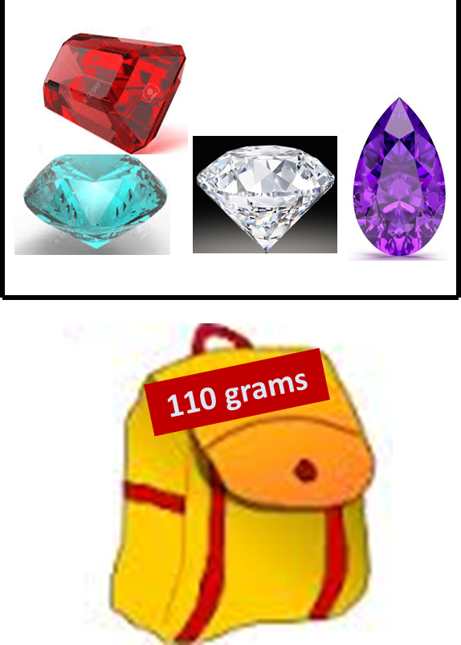
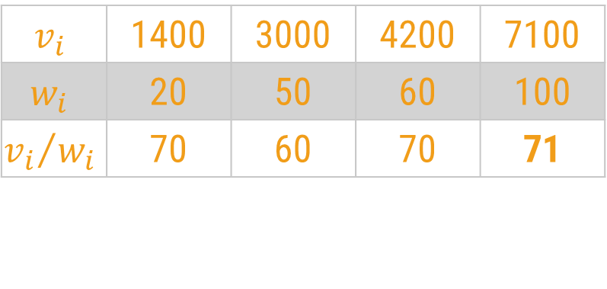
Introduction
A box contains 4 stones worth $1400, $3000, $4200 and $7100. They weigh 20, 50, 60 and 100 grams respectively.
Your bag can only hold 110 grams.
Greedy Approach
The greedy algorithm selects the best candidate with the highest profit, i.e., stone worth $7100.
$$v_{i}$$ | 1400 | 3000 | 4200 | 7100
$$w_{i}$$ | 20 | 50 | 60 | 100
$${v_{i}}/{w_{i}}$$ | 70 | 60 | 70 | 71

Slide 5
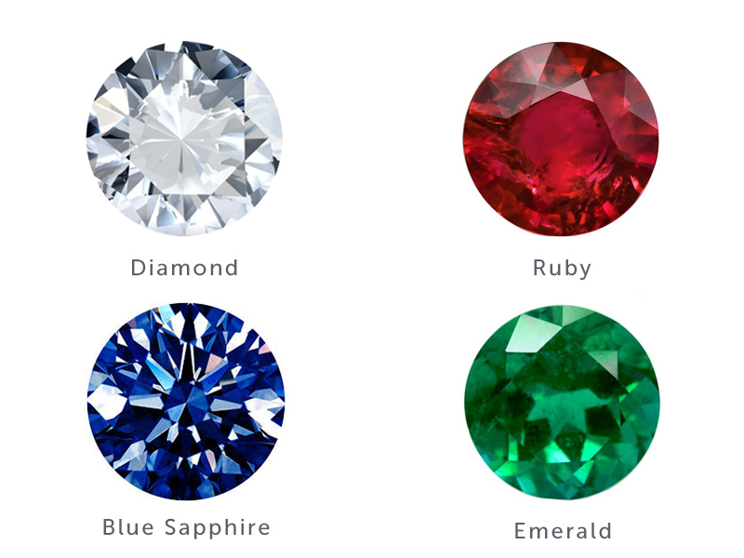

Introduction
A box contains 4 stones worth $1400, $3000, $4200 and $7100. They weigh 20, 50, 60 and 100 grams respectively.
Your bag can only hold 110 grams.
But, the optimal choice would be to select the two stones worth $3000 and $4200.
Their combined weight is 110 grams, which means they will fit into your bag and you will get a profit of $7200.
If there are 100 stones, how to efficiently find the optimal answer?
110 Grams

Slide 6
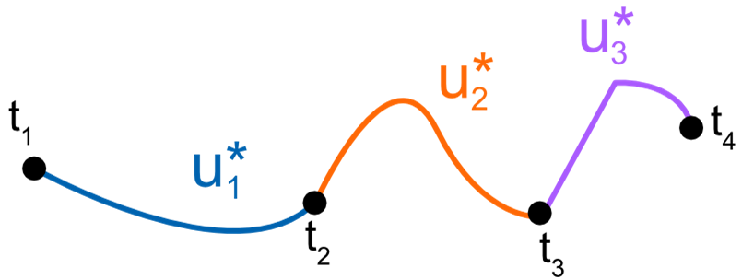
The Principle of Optimality
A dynamic-programming algorithm solves every sub-problem just once and then saves its answer in a table.
It avoids the work of re-computing the answer every time the sub problem is encountered.
The dynamic programming algorithm obtains the solution using principle of optimality.
The principle of optimality states that “in an optimal sequence of decisions or choices, each subsequence must also be optimal.
If it is not possible to apply the principle of optimality then it is almost impossible to obtain the solution using the dynamic programming approach.

Slide 7
Binomial Coefficient

Slide 8
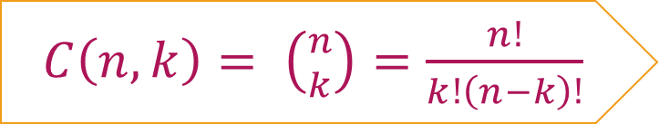
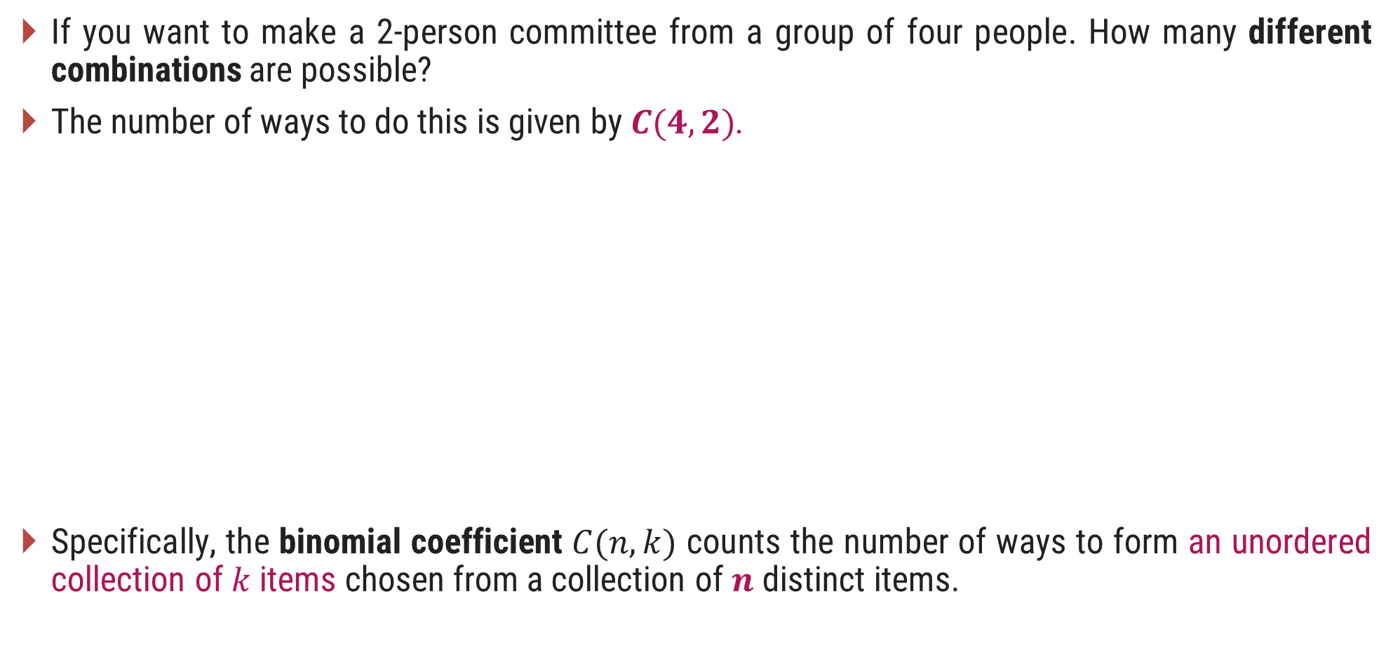
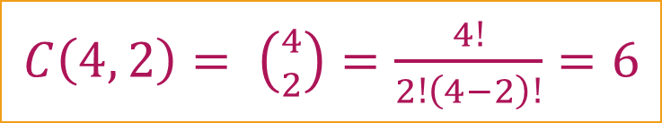
Introduction
If you want to make a 2-person committee from a group of four people. How many different combinations are possible?
The number of ways to do this is given by $C(4, 2)$.
Specifically, the binomial coefficient $C(n, k)$ counts the number of ways to form an unordered collection of $k$ items chosen from a collection of $n$ distinct items.
Consider 4 people A, B, C, D. Now the different combinations for making a committee of 2 persons from these 4 are;
A, B
A, C
A, D
C, D
B, D
B, C
$C\left(n,k\right)= \left({n \atop k}\right)=\frac{n!}{k!\left(n−k\right)!}$
$C\left(4, 2\right)= \left({4 \atop 2}\right)=\frac{4!}{2!\left(4−2\right)!}=6$

Slide 9
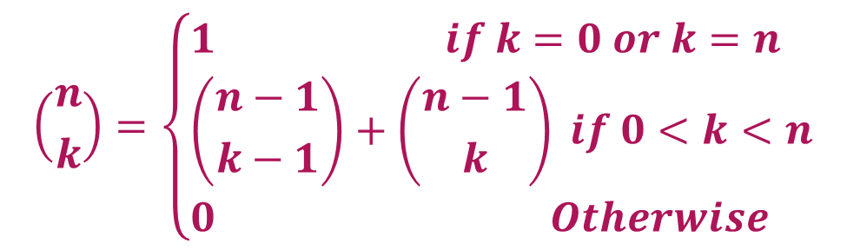
Binomial Coefficient
The definition of binomial coefficient is given as:
$$\left({n \atop k}\right)=\left\{\begin{aligned}&1 if k=0 or k=n \\ &\left({n−1 \atop k−1}\right)+\left({n−1 \atop k}\right) if 0<k<n \\ &0 Otherwise\end{aligned}\right.$$
function C(n, k)
if k=0 or k=n then return 1
else return C(n-1, k-1) + C(n-1, k)

Slide 10
Binomial Coefficient
 | 0 | 1 | 2 | 3 | 4 | 5 | .. | k
0 | 1
1 | 1 | 1
2 | 1 | 2 | 1
3 | 1 | 3 | 3 | 1
4 | 1 | 4 | 6 | 4 | 1
..
n
+
+
+
+
+
+
PASCAL’s TRIANGLE
function C(n, k)
if k=0 or k=n then return 1
else return C(n-1, k-1) + C(n-1, k)

Slide 11
Generalized Solution using Dynamic Programming
Characterize the structure of an optimal solution. (Develop a mathematical notation)
Recursively define the value of an optimal solution.
Compute the value of an optimal solution in a bottom-up fashion.
Construct an optimal solution from the computed information.

Slide 12
Make a Change Problem

Slide 13
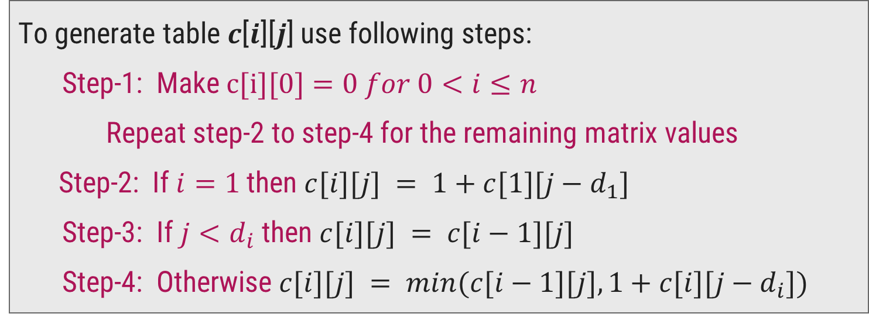
Make Change Problem – Dynamic Programming Solution
We need to generate a table 𝑐[𝑛][𝑁], where
𝑛 = number of denominations
𝑁= amount for which you need to make a change.
To generate table 𝒄[𝒊][𝒋] use following steps:
Step-1: Make $c[i][0]=0$𝑓𝑜𝑟 $0<i≤n$
Repeat step-2 to step-4 for the remaining matrix values
Step-2: If $i=1$then $c[i][j] = 1+c[1][j−d_{1}]$
Step-3: If $j<d_{i}$ then $c[i][j] = c[i−1][j]$
Step-4: Otherwise $c[i][j] = min⁡(c[i−1][j],1+c[i][j−d_{i}])$
Optimal
Sub-structure

Slide 14

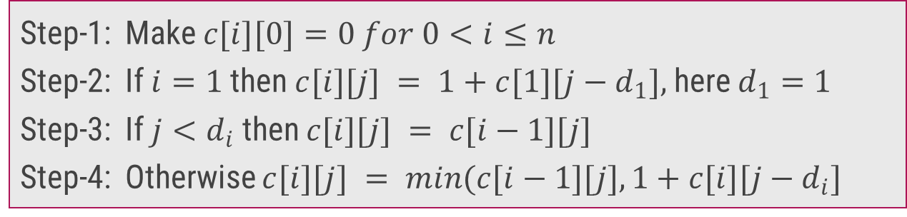
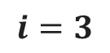
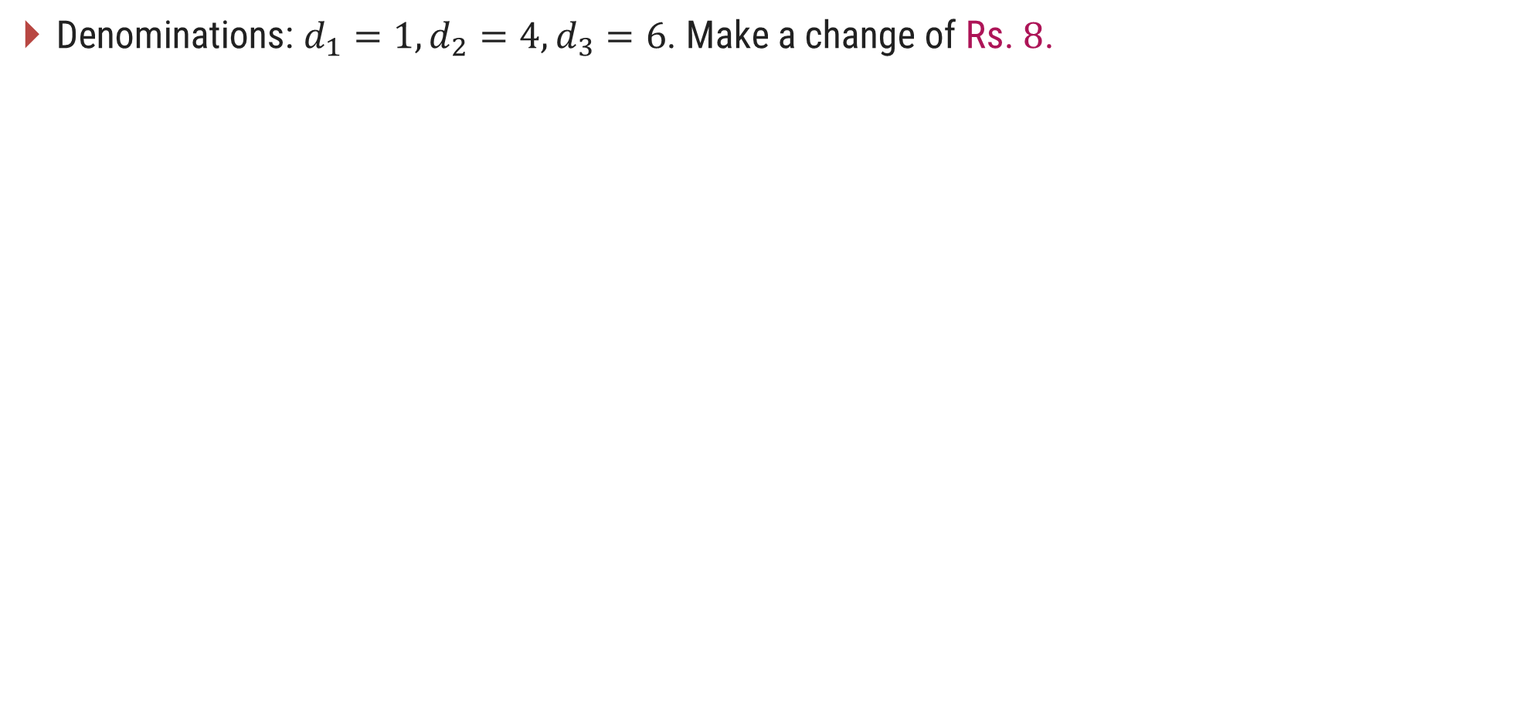
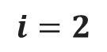
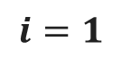
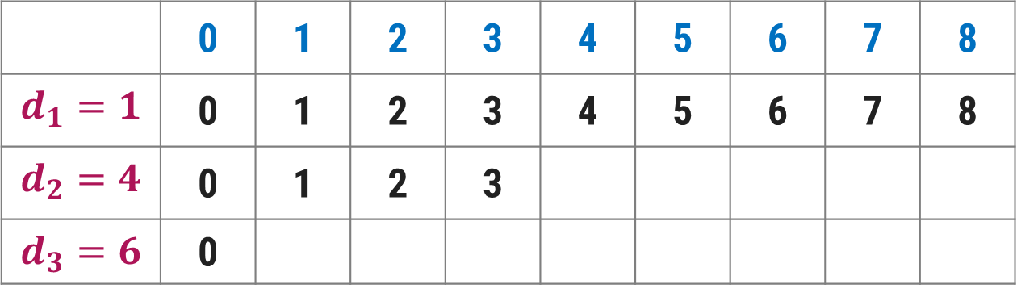
Make Change Problem – Dynamic Programming Solution
Denominations: $d_{1}=1, d_{2}=4, d_{3}=6$. Make a change of Rs. $8$.
Step-1: Make $c[i][0]=0 for 0<i≤n$
Step-2: If $i=1$then $c[i][j] = 1+c[1][j−d_{1}],$here $d_{1}=1$
Step-3: If $j<d_{i}$ then $c[i][j] = c[i−1][j]$
Step-4: Otherwise $c[i][j] = min(c[i−1][j],1+c[i][j−d_{i}]$
$$j$$
Amount
 | 0 | 1 | 2 | 3 | 4 | 5 | 6 | 7 | 8
$$d_{1}=1$$ | 0 | 1 | 2 | 3 | 4 | 5 | 6 | 7 | 8
$$d_{2}=4$$ | 0 | 1 | 2 | 3
$$d_{3}=6$$ | 0
$$i=1$$
$$i=2$$
1
2
$$i=3$$
$$min⁡(c[1][4],1+c[2][0])=min⁡(4,1+0)=min⁡(4,1)=1$$
$$min(c[1][5],1+c[2][1])=min(5,1+1)=min(5,2)=2$$

Slide 15
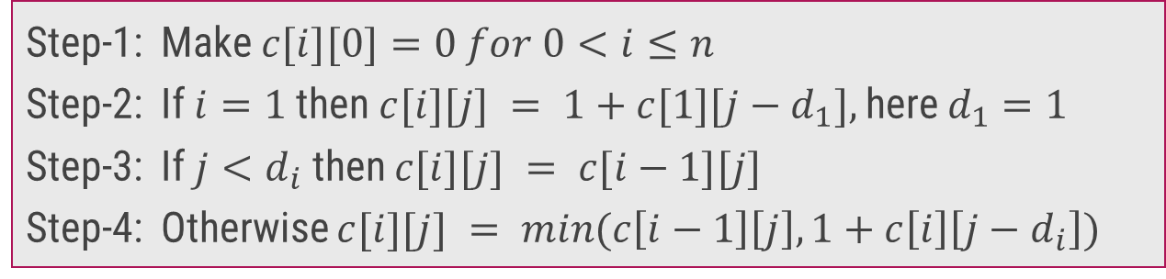
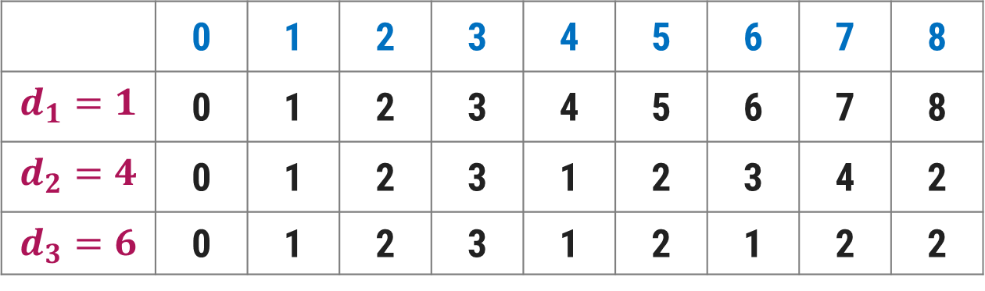
Make Change Problem – Dynamic Programming Solution
Denominations: $d_{1}=1, d_{2}=4, d_{3}=6$. Make a change of Rs. $8$.
Step-1: Make $c[i][0]=0 for 0<i≤n$
Step-2: If $i=1$then $c[i][j] = 1+c[1][j−d_{1}],$here $d_{1}=1$
Step-3: If $j<d_{i}$ then $c[i][j] = c[i−1][j]$
Step-4: Otherwise $c[i][j] = min(c\left[i−1\right]\left[j\right],1+c\left[i\right]\left[j−d_{i}\right])$
$$j$$
Amount
 | 0 | 1 | 2 | 3 | 4 | 5 | 6 | 7 | 8
$$d_{1}=1$$ | 0 | 1 | 2 | 3 | 4 | 5 | 6 | 7 | 8
$$d_{2}=4$$ | 0 | 1 | 2 | 3 | 1 | 2 | 3 | 4 | 2
$$d_{3}=6$$ | 0 | 1 | 2 | 3 | 1 | 2 | 1 | 2 | 2
$$i=1$$
$$i=2$$
$$i=3$$

Slide 16
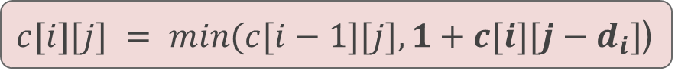
Make Change Problem – Dynamic Programming Solution
We can also find the coins to be included in the solution set as follows:
Start looking at c[3, 8] = c[2, 8] ⟹ So, not to include a coin with denomination 6.
Next go to c[2,8] ≠ c[1, 8] but c[2,8] = 1 + c[2,4]
So, include a coin with denomination 4
Now, got to c[2,4] ≠ c[1,4] but c[2,4] = 1+ c[2,0]
So, again include a coin with denomination 4
Go to c[2,0] = c[1,0] and stop.
$c[i][j] = min(c[i−1][j],1+c[i][j−d_{i}]$)
 | 0 | 1 | 2 | 3 | 4 | 5 | 6 | 7 | 8
$$d_{1}=1$$ | 0 | 1 | 2 | 3 | 4 | 5 | 6 | 7 | 8
$$d_{2}=4$$ | 0 | 1 | 2 | 3 | 1 | 2 | 3 | 4 | 2
$$d_{3}=6$$ | 0 | 1 | 2 | 3 | 1 | 2 | 1 | 2 | 2
Solution contains 2 coins with denomination 4

Slide 17
0/1 Knapsack Problem

Slide 18
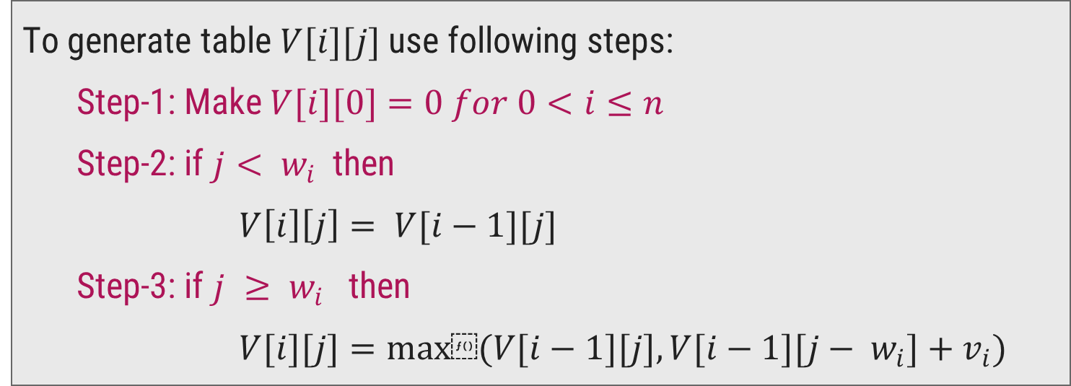
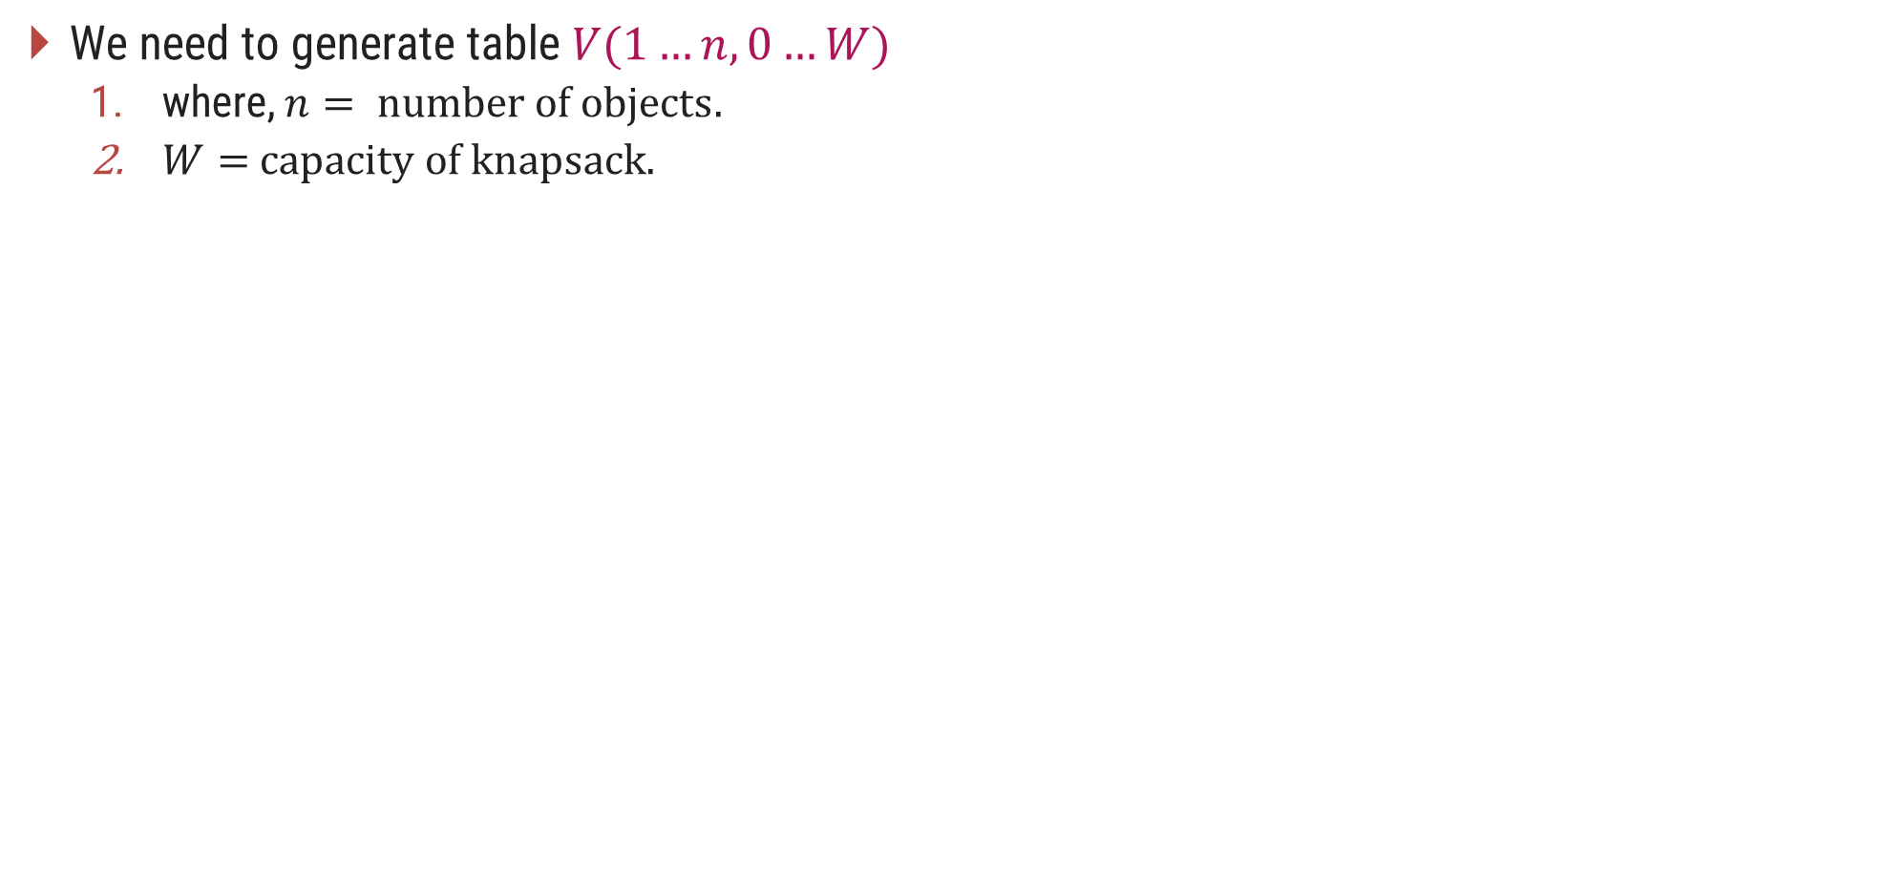
0/1 Knapsack Problem - Dynamic Programming Solution
We need to generate table $V(1…n,0…W)$
where, $n= \text{number} \text{of} \text{objects}.$
$W=$ $\text{capacity} \text{of} \text{knapsack}\text{. }$
To generate table $V[i][j]$use following steps:
Step-1: Make $V[i][0]=0 for 0<i≤n$
Step-2: if $j< w_{i}$then
$V\left[i\right]\left[j\right]= V[i−1][j]$
Step-3: if $j ≥ w_{i}$then
$V[i][j]=max⁡(V[i−1][j], V[i−1][j− w_{i}]+v_{i})$

Slide 19
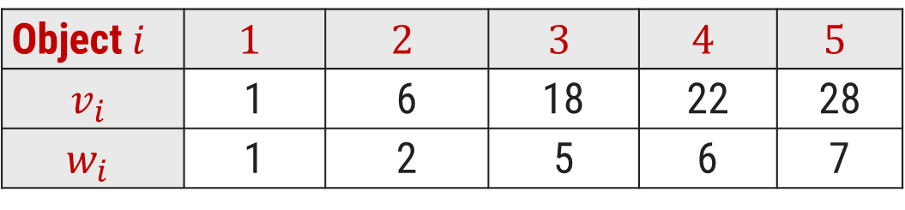
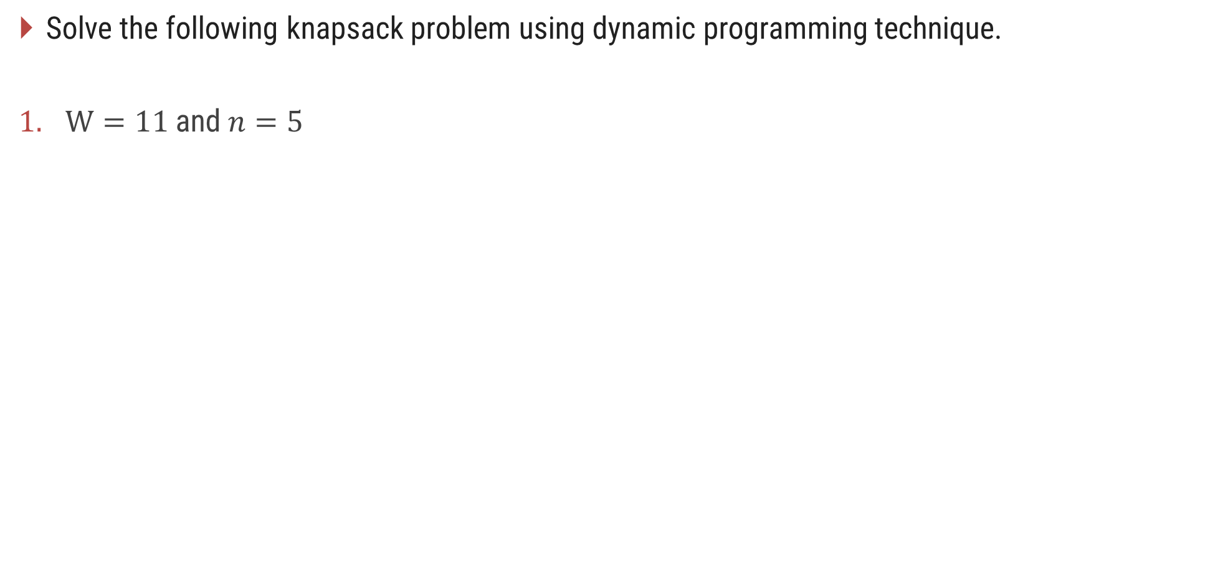
0/1 Knapsack Problem - Dynamic Programming Solution
Solve the following knapsack problem using dynamic programming technique.
$W=11$and $n=5$
Object$i$ | $$1$$ | $$2$$ | $$3$$ | $$4$$ | $$5$$
$$v_{i}$$ | 1 | 6 | 18 | 22 | 28
$$w_{i}$$ | 1 | 2 | 5 | 6 | 7

Slide 20

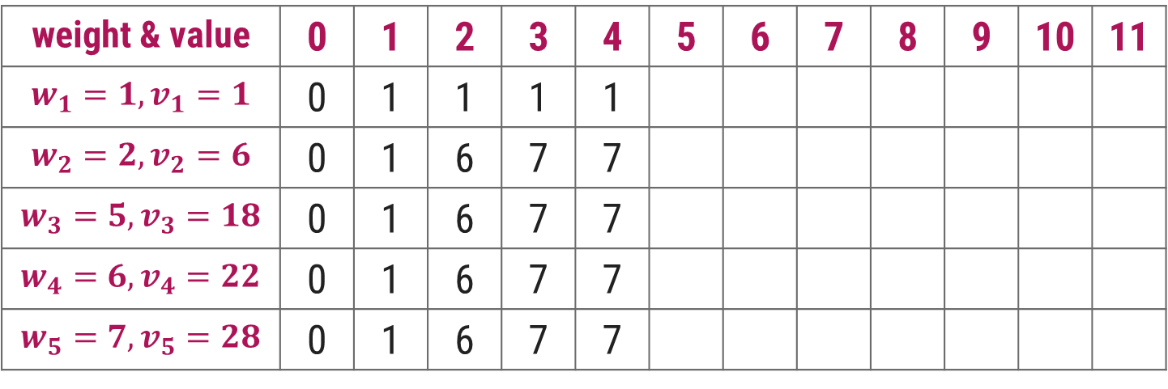
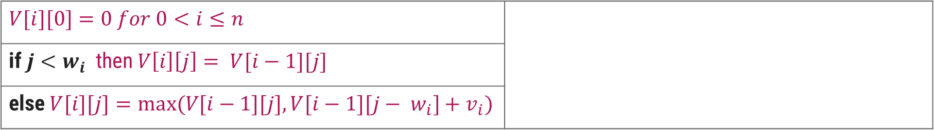
0/1 Knapsack Problem - Dynamic Programming Solution
$$V[i][0]=0 for 0<i≤n$$
if $j<w_{i}$then $V\left[i\right]\left[j\right]= V[i−1][j]$
else $V[i][j]=max⁡(V[i−1][j], V[i−1][j− w_{i}]+v_{i})$
$$j$$
Knapsack Capacity
weight & value | 0 | 1 | 2 | 3 | 4 | 5 | 6 | 7 | 8 | 9 | 10 | 11
$$w_{1}=1, v_{1}=1$$ | 0 | 1 | 1 | 1 | 1
$$w_{2}=2, v_{2}=6$$ | 0 | 1 | 6 | 7 | 7
$$w_{3}=5, v_{3}=18$$ | 0 | 1 | 6 | 7 | 7
$$w_{4}=6, v_{4}=22$$ | 0 | 1 | 6 | 7 | 7
$$w_{5}=7, v_{5}=28$$ | 0 | 1 | 6 | 7 | 7

Slide 21
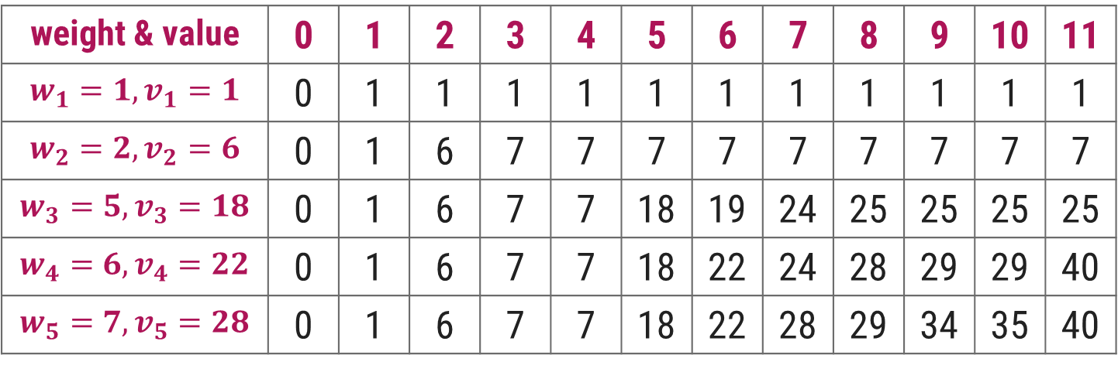
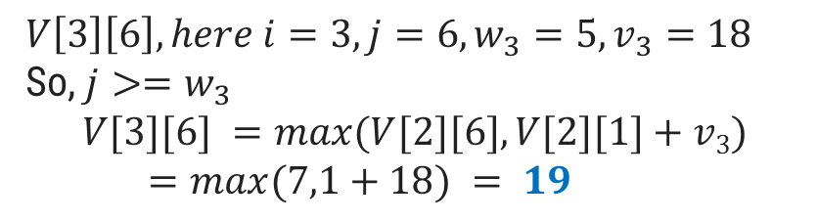
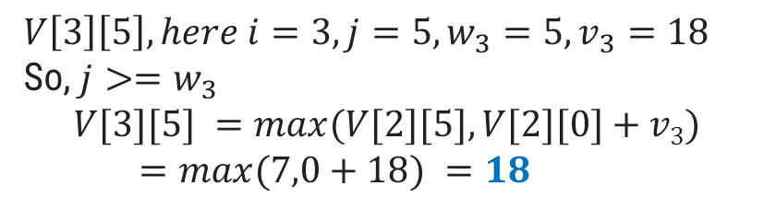
0/1 Knapsack Problem - Dynamic Programming Solution
$$V[i][0]=0 for 0<i≤n$$
if $j<w_{i}$then $V\left[i\right]\left[j\right]= V[i−1][j]$
else $V[i][j]=max⁡(V[i−1][j], V[i−1][j− w_{i}]+v_{i})$
$$V\left[3\right]\left[6\right], here i=3,j=6, w_{3}=5, v_{3}=18$$
So, $j>=w_{3}$
$$V[3][6] =max⁡(V[2][6],V[2][1]+v3)$$
$=max⁡(7,1+18) = 19$
$$V\left[3\right]\left[5\right], here i=3,j=5, w_{3}=5, v_{3}=18$$
So, $j>=w_{3}$
$$V[3][5] =max⁡(V[2][5],V[2][0]+v3)$$
$=max⁡(7,0+18) =18$
$$j$$
Knapsack Capacity
weight & value | 0 | 1 | 2 | 3 | 4 | 5 | 6 | 7 | 8 | 9 | 10 | 11
$$w_{1}=1, v_{1}=1$$ | 0 | 1 | 1 | 1 | 1 | 1 | 1 | 1 | 1 | 1 | 1 | 1
$$w_{2}=2, v_{2}=6$$ | 0 | 1 | 6 | 7 | 7 | 7 | 7 | 7 | 7 | 7 | 7 | 7
$$w_{3}=5, v_{3}=18$$ | 0 | 1 | 6 | 7 | 7 | 18 | 19 | 24 | 25 | 25 | 25 | 25
$$w_{4}=6, v_{4}=22$$ | 0 | 1 | 6 | 7 | 7 | 18 | 22 | 24 | 28 | 29 | 29 | 40
$$w_{5}=7, v_{5}=28$$ | 0 | 1 | 6 | 7 | 7 | 18 | 22 | 28 | 29 | 34 | 35 | 40

Slide 22
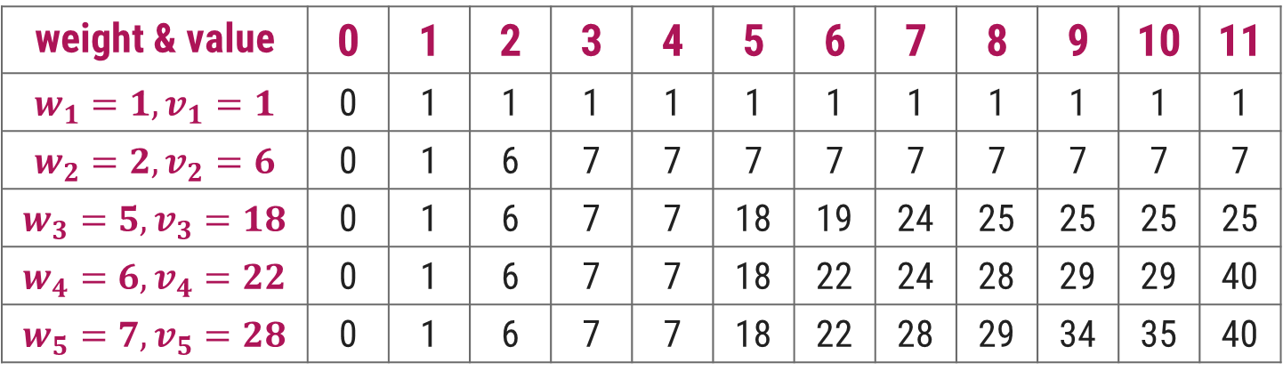
0/1 Knapsack Problem - Dynamic Programming Solution
We can also find the objects to be carried in the knapsack as follows,
Start looking at V[5, 11] = V[4, 11] ⟹ So not to include object 5
Next go to V[4, 11] ≠ V[3, 11] but V[4, 11] = V[3,11-w₄]+v₄ = V[3, 5]+22 So include object 4
Now go to V[3,5] ≠ V[2,5] but V[3,5] = V[2,5-w₃]+v₃ = V[2,0]+18 So include object 3
Now V[2,0] = V[1, 0] and V[1,0] = V[0,0] ⟹ So objects 2 and 1 are not included.
$$V[i][j]=max⁡(V[i−1][j], V[i−1][j− wi]+v_{i})$$
weight & value | 0 | 1 | 2 | 3 | 4 | 5 | 6 | 7 | 8 | 9 | 10 | 11
$$w_{1}=1, v_{1}=1$$ | 0 | 1 | 1 | 1 | 1 | 1 | 1 | 1 | 1 | 1 | 1 | 1
$$w_{2}=2, v_{2}=6$$ | 0 | 1 | 6 | 7 | 7 | 7 | 7 | 7 | 7 | 7 | 7 | 7
$$w_{3}=5, v_{3}=18$$ | 0 | 1 | 6 | 7 | 7 | 18 | 19 | 24 | 25 | 25 | 25 | 25
$$w_{4}=6, v_{4}=22$$ | 0 | 1 | 6 | 7 | 7 | 18 | 22 | 24 | 28 | 29 | 29 | 40
$$w_{5}=7, v_{5}=28$$ | 0 | 1 | 6 | 7 | 7 | 18 | 22 | 28 | 29 | 34 | 35 | 40

Slide 23
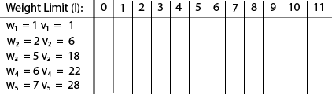
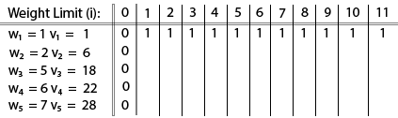
0/1 Knapsack Problem - Dynamic Programming Example

Slide 24
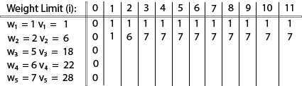
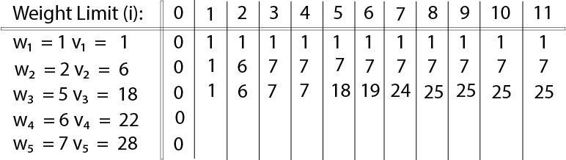
0/1 Knapsack Problem - Dynamic Programming Example

Slide 25
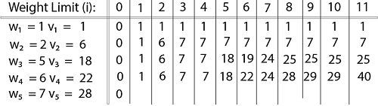
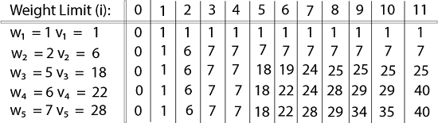
0/1 Knapsack Problem - Dynamic Programming Example

Slide 26
All Pair Shortest Path – Floyd’s Algorithm

Slide 27
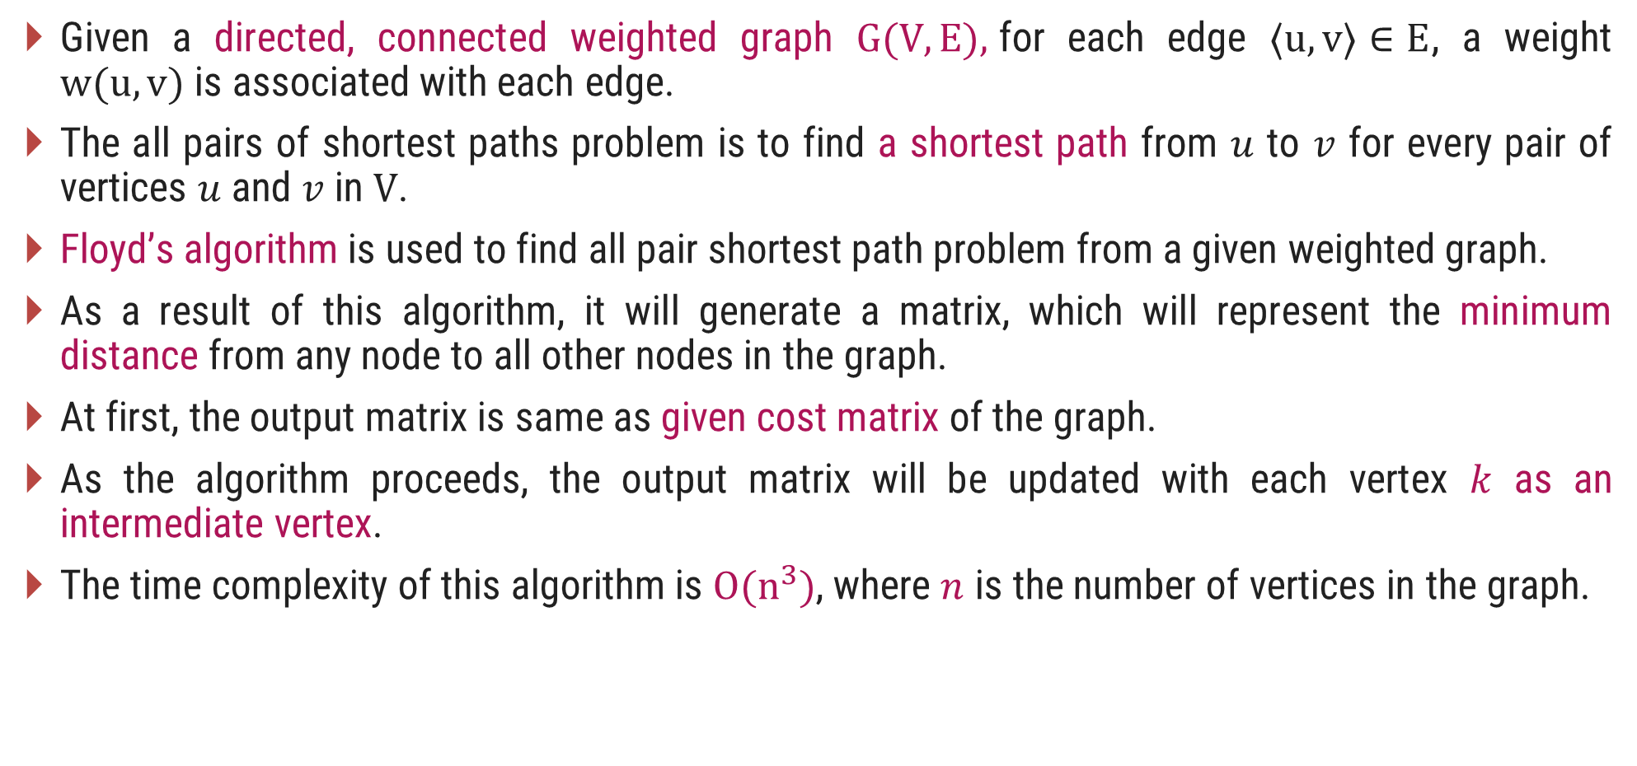
Introduction
Given a directed, connected weighted graph $G(V, E),$for each edge $⟨u, v⟩∈E$, a weight $w(u, v)$is associated with each edge.
The all pairs of shortest paths problem is to find a shortest path from $u$ to $v$ for every pair of vertices $u$ and $v$ in $V$.
Floyd’s algorithm is used to find all pair shortest path problem from a given weighted graph.
As a result of this algorithm, it will generate a matrix, which will represent the minimum distance from any node to all other nodes in the graph.
At first, the output matrix is same as given cost matrix of the graph.
As the algorithm proceeds, the output matrix will be updated with each vertex $k$ as an intermediate vertex.
The time complexity of this algorithm is $O(n^{3})$, where $n$ is the number of vertices in the graph.

Slide 28
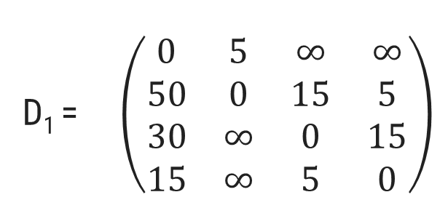
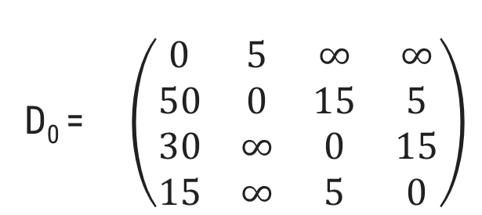
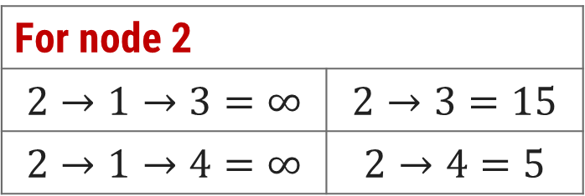
Floyd Algorithm - Example
Step: 2
Calculate the distance between each node with node 1 as an intermediate node.
1
15
4
30
5
5
50
5
15
1 | 2 | 3 | 4
D₁ = $\left(\begin{matrix}0 & 5 & ∞ & ∞ \\ 50 & 0 & 15 & 5 \\ 30 & ∞ & 0 & 15 \\ 15 & ∞ & 5 & 0\end{matrix}\right)$
2
3
1
2
3
4
15
Step: 1
Initialization
1 | 2 | 3 | 4
D₀ = $\left(\begin{matrix}0 & 5 & ∞ & ∞ \\ 50 & 0 & 15 & 5 \\ 30 & ∞ & 0 & 15 \\ 15 & ∞ & 5 & 0\end{matrix}\right)$
1
2
3
4
For node 2
$$2→1→3=∞$$ | $$2→3=15$$
$$2→1→4=∞$$ | $$2→4=5$$
No change

Slide 29

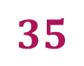
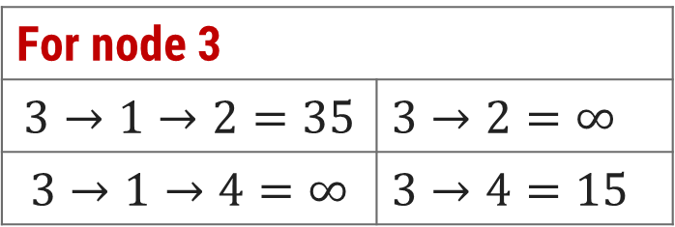
Floyd Algorithm - Example
Step: 2
Calculate the distance between each node with node 1 as an intermediate node.
1
15
4
30
5
5
50
5
15
1 | 2 | 3 | 4
D₁ = $\left(\begin{matrix}0 & 5 & ∞ & ∞ \\ 50 & 0 & 15 & 5 \\ 30 & ∞ & 0 & 15 \\ 15 & ∞ & 5 & 0\end{matrix}\right)$
2
3
1
2
3
4
15
$$35$$
Step: 1
Initialization
1 | 2 | 3 | 4
D₀ = $\left(\begin{matrix}0 & 5 & ∞ & ∞ \\ 50 & 0 & 15 & 5 \\ 30 & ∞ & 0 & 15 \\ 15 & ∞ & 5 & 0\end{matrix}\right)$
1
2
3
4
For node 3
$$3→1→2=35$$ | $$3→2=∞$$
$$3→1→4=∞$$ | $$3→4=15$$

Slide 30
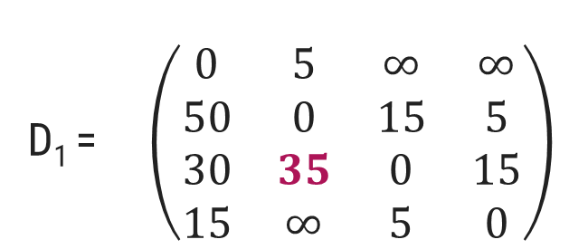

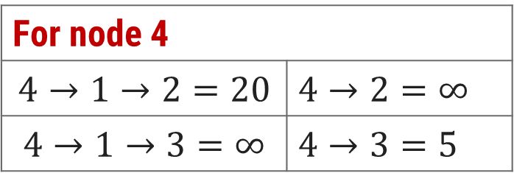
Floyd Algorithm - Example
Step: 2
Calculate the distance between each node with node 1 as an intermediate node.
1
15
4
30
5
5
50
5
15
1 | 2 | 3 | 4
D₁ = $\left(\begin{matrix}0 & 5 & ∞ & ∞ \\ 50 & 0 & 15 & 5 \\ 30 & 35 & 0 & 15 \\ 15 & ∞ & 5 & 0\end{matrix}\right)$
2
3
1
2
3
4
15
Step: 1
Initialization
$$20$$
1 | 2 | 3 | 4
D₀ = $\left(\begin{matrix}0 & 5 & ∞ & ∞ \\ 50 & 0 & 15 & 5 \\ 30 & ∞ & 0 & 15 \\ 15 & ∞ & 5 & 0\end{matrix}\right)$
1
2
3
4
For node 4
$$4→1→2=20$$ | $$4→2=∞$$
$$4→1→3=∞$$ | $$4→3=5$$

Slide 31
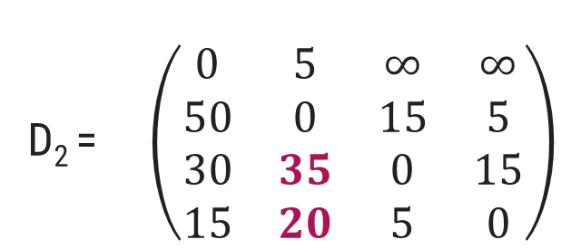


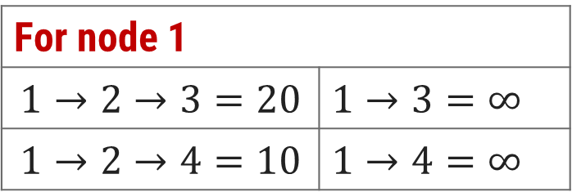
Floyd Algorithm - Example
Step: 3
Calculate the distance between each node with node 2 as an intermediate node.
1
15
4
30
5
5
50
5
15
1 | 2 | 3 | 4
D₂ = $\left(\begin{matrix}0 & 5 & ∞ & ∞ \\ 50 & 0 & 15 & 5 \\ 30 & 35 & 0 & 15 \\ 15 & 20 & 5 & 0\end{matrix}\right)$
2
3
1
2
3
4
$$20$$
$$10$$
15
Step: 1
Initialization
1 | 2 | 3 | 4
D₀ = $\left(\begin{matrix}0 & 5 & ∞ & ∞ \\ 50 & 0 & 15 & 5 \\ 30 & ∞ & 0 & 15 \\ 15 & ∞ & 5 & 0\end{matrix}\right)$
1
2
3
4
For node 1
$$1→2→3=20$$ | $$1→3=∞$$
$$1→2→4=10$$ | $$1→4=∞$$
No change for Node 3 & 4

Slide 32
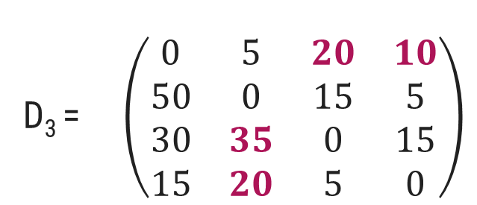
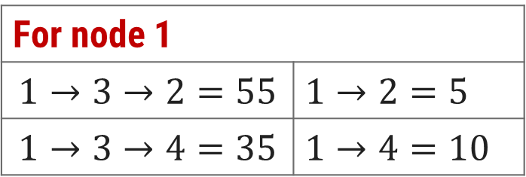
Floyd Algorithm - Example
Step: 4
Calculate the distance between each node with node 3 as an intermediate node.
1
15
4
30
5
5
50
5
15
1 | 2 | 3 | 4
D₃ = $\left(\begin{matrix}0 & 5 & 20 & 10 \\ 50 & 0 & 15 & 5 \\ 30 & 35 & 0 & 15 \\ 15 & 20 & 5 & 0\end{matrix}\right)$
2
3
1
2
3
4
15
Step: 1
Initialization
1 | 2 | 3 | 4
D₀ = $\left(\begin{matrix}0 & 5 & ∞ & ∞ \\ 50 & 0 & 15 & 5 \\ 30 & ∞ & 0 & 15 \\ 15 & ∞ & 5 & 0\end{matrix}\right)$
1
2
3
4
For node 1
$$1→3→2=55$$ | $$1→2=5$$
$$1→3→4=35$$ | $$1→4=10$$
No change

Slide 33
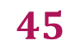
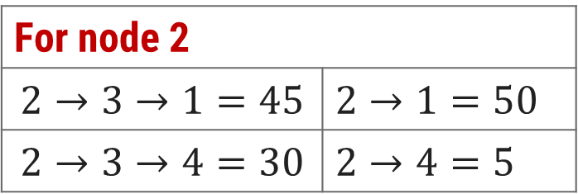
Floyd Algorithm - Example
Step: 4
Calculate the distance between each node with node 3 as an intermediate node.
1
15
4
30
5
5
50
5
15
1 | 2 | 3 | 4
D₃ = $\left(\begin{matrix}0 & 5 & 20 & 10 \\ 50 & 0 & 15 & 5 \\ 30 & 35 & 0 & 15 \\ 15 & 20 & 5 & 0\end{matrix}\right)$
2
3
1
2
3
4
15
$$45$$
Step: 1
Initialization
1 | 2 | 3 | 4
D₀ = $\left(\begin{matrix}0 & 5 & ∞ & ∞ \\ 50 & 0 & 15 & 5 \\ 30 & ∞ & 0 & 15 \\ 15 & ∞ & 5 & 0\end{matrix}\right)$
1
2
3
4
For node 2
$$2→3→1=45$$ | $$2→1=50$$
$$2→3→4=30$$ | $$2→4=5$$
No change for Node 4

Slide 34
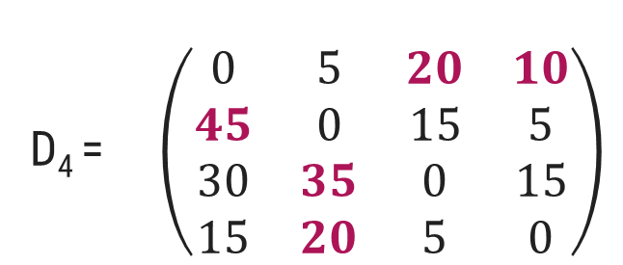

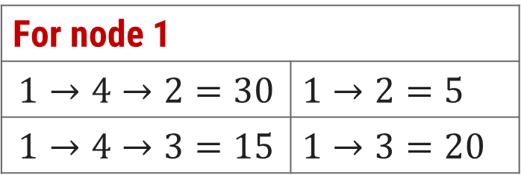
Floyd Algorithm - Example
Step: 5
Calculate the distance between each node with node 4 as an intermediate node.
1
15
4
30
5
5
50
5
15
1 | 2 | 3 | 4
D₄ = $\left(\begin{matrix}0 & 5 & 20 & 10 \\ 45 & 0 & 15 & 5 \\ 30 & 35 & 0 & 15 \\ 15 & 20 & 5 & 0\end{matrix}\right)$
2
3
1
2
3
4
$$15$$
15
Step: 1
Initialization
1 | 2 | 3 | 4
D₀ = $\left(\begin{matrix}0 & 5 & ∞ & ∞ \\ 50 & 0 & 15 & 5 \\ 30 & ∞ & 0 & 15 \\ 15 & ∞ & 5 & 0\end{matrix}\right)$
1
2
3
4
For node 1
$$1→4→2=30$$ | $$1→2=5$$
$$1→4→3=15$$ | $$1→3=20$$

Slide 35




Floyd Algorithm - Example
Step: 5
Calculate the distance between each node with node 4 as an intermediate node.
1
15
4
30
5
5
50
5
15
1 | 2 | 3 | 4
D₄ = $\left(\begin{matrix}0 & 5 & 15 & 10 \\ 45 & 0 & 15 & 5 \\ 30 & 35 & 0 & 15 \\ 15 & 20 & 5 & 0\end{matrix}\right)$
2
3
1
2
3
4
15
$$20$$
$$10$$
Step: 1
Initialization
1 | 2 | 3 | 4
D₀ = $\left(\begin{matrix}0 & 5 & ∞ & ∞ \\ 50 & 0 & 15 & 5 \\ 30 & ∞ & 0 & 15 \\ 15 & ∞ & 5 & 0\end{matrix}\right)$
1
2
3
4
For node 2
$$2→4→1=20$$ | $$2→1=45$$
$$2→4→3=10$$ | $$2→3=15$$
No change for Node 3

Slide 36

Floyd Algorithm - Example
Step: 5
Calculate the distance between each node with node 4 as an intermediate node.
1
15
4
30
5
5
50
5
15
1 | 2 | 3 | 4
D₄ = $\left(\begin{matrix}0 & 5 & 15 & 10 \\ 20 & 0 & 10 & 5 \\ 30 & 35 & 0 & 15 \\ 15 & 20 & 5 & 0\end{matrix}\right)$
2
3
1
2
3
4
15
Step: 1
Initialization
1 | 2 | 3 | 4
D₀ = $\left(\begin{matrix}0 & 5 & ∞ & ∞ \\ 50 & 0 & 15 & 5 \\ 30 & ∞ & 0 & 15 \\ 15 & ∞ & 5 & 0\end{matrix}\right)$
1
2
3
4
Final Solution

Slide 37
Floyd’s Algorithm
function Floyd(L[1..n, 1..n]):array [1..n, 1..n]
array D[1..n, 1..n]
D ← L
for k ← 1 to n do
for i ← 1 to n do
for j ← 1 to n do
D[i,j] ← min(D[i,j], D[i,k]+ D[k,j])
return D

Slide 38



Floyd Algorithm - Example

Slide 39
Assembly Line Scheduling

Slide 40


Introduction
An automobile chassis enters each assembly line, has parts added to it at a number of stations, and a finished auto exits at the end of the line.
There are two assembly lines, numbered $i = 1, 2$.
Each assembly line has $n$ stations, numbered $j = 1, 2,…,n$

Slide 41

Introduction
We denote the $j^{th}$ station on line $i$by $S_{i,j}.$
The $j^{th}$ station on line$1$ $(S_{1,j})$performs the same function as the $j^{th}$ station on line $2 (S_{2,j}).$
Corresponding stations $S_{1,j}$ and $S_{2,j}$ perform the same function but can take different amounts of time $a_{1,j}$and $a_{2,j}$.

Slide 42

Introduction
Entry times are: $e_{1}$and $e_{2}$; exit times are: $x_{1}$and $x_{2}$
After going through a station, a chassis can either:
stay on same line at no cost, or
transfer to other line: cost after $S_{i,j}$ is $T_{i,j}$ for $j=1, . . . , n –1$

Slide 43

Assembly Line Scheduling - Example
Using dynamic programming technique, find the fastest time to get through the entire factory for the following:

Slide 44





Optimal Substructure
Step 1:
$f^{∗}$: the fastest time to get through the entire factory
$f_{i}\left[j\right]$: the fastest time to get from the starting point through station $S_{i,j}$.
Base case: $j=1, i=1, 2$(getting through station $1$)
$f_{1}[1] = e_{1}+a_{1,1}$
$$f_{2}[1] = e_{2}+ a_{2,1}$$

Slide 45


Assembly Line Scheduling – Dynamic Programming Solution
General Case: 𝑗 = 2, 3, …,𝑛 and 𝑖 = 1, 2 - Recursive solution

Slide 46


Assembly Line Scheduling – Dynamic Programming Solution
 | j = 1 | j = 2 | j = 3 | j = 4 | j = 5 | j = 6
$$f_{1}\left[j\right]$$ | 9 |  | 20 | 24 | 32 | 35
$$f_{2}\left[j\right]$$ | 12 | 16 | 22 | 25 | 30 | 37
$f1\left[1\right] here, j=1, \text{s}\text{o}\text{,} f1[1]=e1+a1,1$ $f1\left[1\right]=2+7=9$
$f2\left[1\right] here, j=1, \text{so}\text{,} f2[1]=e2+a2,1$ $f2[1]=4+8=12$

Slide 47


Assembly Line Scheduling – Dynamic Programming Solution
 | j = 1 | j = 2 | j = 3 | j = 4 | j = 5 | j = 6
$$f_{1}\left[j\right]$$ | 9 | 18 | 20 | 24 | 32 | 35
$$f_{2}\left[j\right]$$ | 12 | 16 | 22 | 25 | 30 | 37
$$f1[2]=min⁡(f1[j−1]+a1,j ,f2[j −1]+t_{2,j−1}+a1,j)$$
$$=\min\left(9+9, 12+2+9\right)=min⁡(18, 23)=18$$

Slide 48

Assembly Line Scheduling – Dynamic Programming Solution
 | j = 1 | j = 2 | j = 3 | j = 4 | j = 5 | j = 6
$$f_{1}\left[j\right]$$ | 9 | 18 | 20 | 24 | 32 | 35
$$f_{2}\left[j\right]$$ | 12 | 16 | 22 | 25 | 30 | 37
$$Min (18+3, 16+1+3)=\min\left(21, 20\right)= 20$$

Slide 49



Assembly Line Scheduling – Dynamic Programming Solution
 | j = 1 | j = 2 | j = 3 | j = 4 | j = 5 | j = 6
$$f_{1}\left[j\right]$$ | 9 | 18 | 20 | 24 | 32 | 35
$$f_{2}\left[j\right]$$ | 12 | 16 | 22 | 25 | 30 | 37
$$f^{∗ }=min\left(f_{1}\left[n\right]+x_{1},f_{2}\left[n\right]+x_{2}\right)$$
$$f^{∗}= min⁡(35+3, 37+2) = 38$$

Slide 50
Example

Slide 51

Example

Slide 52
Chain Matrix Multiplication

Slide 53




Introduction
$A=\left[\begin{matrix}A_{11} & A_{12} & A_{13} \\ A_{21} & A_{22} & A_{23}\end{matrix}\right]$ and $B=\left[\begin{matrix}B_{11} & B_{12} \\ B_{21} & B_{22} \\ B_{31} & B_{32}\end{matrix}\right]$
$$C_{11}=A_{11}∙B_{11}+A_{12}∙B_{21}+A_{13}∙B_{31}$$
$$C_{12}=A_{11}∙B_{12}+A_{12}∙B_{22}+A_{13}∙B_{32}$$
$$C_{21}=A_{21}∙B_{11}+A_{22}∙B_{21}+A_{23}∙B_{31}$$
$$C_{22}=A_{21}∙B_{12}+A_{22}∙B_{22}+A_{23}∙B_{32}$$
Let matrix $A (p× q)$and matrix $B (q × r)$are two given matrices for multiplication.
The resultant matrix $C=A ∙B$
So,
Suppose, matrix $A (2×3)$and matrix $B (3×2)$are given.
The product $C=A ∙B$and the dimension of matrix $C$ is $2×2$
The total number of scalar multiplications required will be,
$C_{ij}=\sum_{k=1}^{q}{a_{ik}b_{kj}}$ Where, $1≤i≤p$and $1≤j≤r$
$$p∗q∗r=2∗3∗2=12$$

Slide 54




Matrix Chain Multiplication
Now, we want to calculate the product of more than two matrices. Matrix multiplication is associative.
The product of four matrices $A(13×5), B(5×89), C(89×3), D(3×34)$ can be fully parenthesized in $5$ distinct ways.
1 | $$((AB)C)D$$ | $$10582$$
$$R1=A(13×5)∙B(5×89)$$ | $$13∗5∗89=5785$$
Dimension of $R1 (13×89)$
$$R2=R1(13×89) . C(89×3)$$ | $$13∗89∗3=3471$$
Dimension of $R2 (13×3)$
$$R3=R2(13×3) . D(3×34)$$ | $$13∗3∗34=1326$$
Dimension of $R3 (13×34)$
$$10582$$

Slide 55



Matrix Chain Multiplication
Now, we want to calculate the product of more than two matrices. Matrix multiplication is associative.
The product of four matrices $A(13×5), B(5×89), C(89×3), D(3×34)$ can be fully parenthesized in $5$ distinct ways.
1 | $$((AB)C)D$$ | $$10582$$
2 | $$(AB)(CD)$$ | $$54201$$
3 | $$(A(BC))D$$ | $$2856$$
4 | $$A((BC)D)$$ | $$4055$$
5 | $$A(B(CD))$$ | $$26418$$
$$R1=A(13×5)∙B(5×89)$$ | $$13∗5∗89=5785$$
Dimension of $R1 (13×89)$
$$R2=C(89×3) . D(3×34)$$ | $$89∗3∗34=9078$$
Dimension of $R2 (89×34)$
$$R3=R1(13×89) . R2(89×34)$$ | $$13∗89∗34=39338$$
Dimension of $R3 (13×34)$
$$54201$$

Slide 56


Matrix Chain Multiplication using Dynamic Programming
Matrix table $M[i][j]$stores the cost of multiplications.
To generate $M[i][j]$use following steps:
Step-1: if $i=j$then $M[i][j]=0$
Step-2: if $j=i+1$then $M[i][j] = P_{i−1}∙P_{i}∙P_{i+1}$
Step-3: if $i<j$then
$$M[i][j]= min⁡(M[i][k]+M[k+1][j]+P_{i−1}∙P_{k}∙P_{j}) with i≤k<j$$

Slide 57


Matrix Chain Multiplication using Dynamic Programming
Here dimensions are, $P_{0}=5,P_{1}=4,P_{2}=6,P_{3}=2,P_{4}=7.$
There would be $4$matrices $A(5×4$),$B(4×6), C(6×2)$and $D(2×7).$
Step-2: if $j=i+1$then $M[i][j] = P_{i−1}∙P_{i}∙P_{i+1}$
Step-1: if $i=j$then $M[i][j]=0$
So, $M[1][1] = M[2][2] = M[3][3] = M[4][4] = 0$
$$M[1][2] = P_{0} ∗P_{1}∗P_{2}= 5 ∗ 4 ∗ 6 = 120$$
$$M[2][3] = P_{1} ∗P_{2}∗P_{3}=4 ∗6 ∗2 =48$$
$$M[3][4] = P_{2} ∗P_{3}∗P_{4}=6 ∗2 ∗7 =84$$
M | 1 | 2 | 3 | 4
1 | 0 | 120
2 | -- | 0 | 48
3 | -- | -- | 0 | 84
4 | -- | -- | -- | 0
S | 1 | 2 | 3 | 4
1 |  | 1
2 |  |  | 2
3 |  |  |  | 3
4

Slide 58




Matrix Chain Multiplication using Dynamic Programming
Here dimensions are,
$P_{0}=5,P_{1}=4,P_{2}=6,P_{3}=2,P_{4}=7.$
$$M\left[1\right]\left[3\right], here i<j$$
$$for i=1,j=3 and k=1 or 2$$
$$because i≤k≤ j−1$$
$$For k=1$$
$$M[1][3]=M[1][1]+M[2][3]+P0∗P1∗P3$$
$$=0+48+5∗4∗2$$
$$M[1][3]=88$$
$$For k=2$$
$$M[1][3]=M[1][2]+M[3][3]+P0∗P2∗P3$$
$$=120+0+5∗6∗2$$
$$M[1][3]=180$$
step 3:
$$M\left[i\right]\left[j\right]=min\left(M\left[i\right]\left[k\right]+M\left[k+1\right]\left[j\right]+P_{i−1}∙P_{k}∙P_{j}\right)$$
$$with i≤k<j$$
 | 1 | 2 | 3 | 4
1 | 0 | 120 | 88
2 | -- | 0 | 48
3 | -- | -- | 0 | 84
4 | -- | -- | -- | 0

Slide 59


Matrix Chain Multiplication using Dynamic Programming
Here dimensions are,
$P_{0}=5,P_{1}=4,P_{2}=6,P_{3}=2,P_{4}=7.$
$$M\left[2\right]\left[4\right], here i<j$$
$$for i=2,j=4 and k=2 or 3$$
$$because i≤k≤ j−1$$
$$For k=2$$
$$M[2][4]=M[2][2]+M[3][4]+P1∗P2∗P4$$
$$=0+84+4∗6∗7$$
$$M[1][3]=252$$
$$For k=3$$
$$M[2][4]=M[2][3]+M[4][4]+P1∗P3∗P4$$
$$=48+0+4∗2∗7$$
$$M[2][4]=104$$
step 3:
$$M\left[i\right]\left[j\right]=min\left(M\left[i\right]\left[k\right]+M\left[k+1\right]\left[j\right]+P_{i−1}∙P_{k}∙P_{j}\right)$$
$$with i≤k<j$$
 | 1 | 2 | 3 | 4
1 | 0 | 120 | 88
2 | -- | 0 | 48 | 104
3 | -- | -- | 0 | 84
4 | -- | -- | -- | 0

Slide 60


Matrix Chain Multiplication using Dynamic Programming
Here dimensions are,
$P_{0}=5,P_{1}=4,P_{2}=6,P_{3}=2,P_{4}=7.$
$$M\left[1\right]\left[4\right], here i < j$$
$$for i=1,j=4 and k=1 or 2 or 3$$
$$because i ≤ k ≤ j−1$$
$$For k=1$$
$$M[1][4]=M[1][1]+M[2][4]+P0∗P1∗P4$$
$$= 0+104+5∗4∗7 = 244$$
$$For k=2$$
$$M[1][4]=M[1][2]+M[3][4]+P0∗P2∗P4$$
$$= 120+84+5∗6∗7 = 414$$
$$For k=3$$
$$M[1][4]=M[1][3]+M[4][4]+P0∗P3∗P4$$
$$= 88+0+5∗2∗7=158$$
step 3:
$$M\left[i\right]\left[j\right]=min\left(M\left[i\right]\left[k\right]+M\left[k+1\right]\left[j\right]+P_{i−1}∙P_{k}∙P_{j}\right)$$
$$with i≤k<j$$
 | 1 | 2 | 3 | 4
1 | 0 | 120 | 88 | 158
2 | -- | 0 | 48 | 104
3 | -- | -- | 0 | 84
4 | -- | -- | -- | 0

Slide 61

Matrix Chain Multiplication using Dynamic Programming
How to parenthesize matrices?
$$M\left[1\right]\left[4\right], here i < j$$
$$for i=1,j=4 and k=1 or 2 or 3$$
$$because i ≤ k ≤ j−1$$
$$For k=1$$
$$M[1][4]=M[1][1]+M[2][4]+P0∗P1∗P4$$
$$= 0+104+5∗4∗7 = 244$$
$$For k=2$$
$$M[1][4]=M[1][2]+M[3][4]+P0∗P2∗P4$$
$$= 120+84+5∗6∗7 = 414$$
$$For k=3$$
$$M[1][4]=M[1][3]+M[4][4]+P0∗P3∗P4$$
$$= 88+0+5∗2∗7=158$$
A B C D
 | 1 | 2 | 3 | 4
1 | 0 | 120 | 88 | 158
2 | -- | 0 | 48 | 104
3 | -- | -- | 0 | 84
4 | -- | -- | -- | 0

Slide 62
Matrix Chain Multiplication using Dynamic Programming
How to parenthesize matrices?
$$M\left[1\right]\left[3\right], here i<j$$
$$for i=1,j=3 and k=1 or 2$$
$$because i≤k≤ j−1$$
$$For k=1$$
$$M[1][3]=M[1][1]+M[2][3]+P0∗P1∗P3$$
$$=0+48+5∗4∗2$$
$$M[1][3]=88$$
$$For k=2$$
$$M[1][3]=M[1][2]+M[3][3]+P0∗P2∗P3$$
$$=120+0+5∗6∗2$$
$$M[1][3]=180$$
A B C D
 | 1 | 2 | 3 | 4
1 | 0 | 120 | 88 | 158
2 | -- | 0 | 48 | 104
3 | -- | -- | 0 | 84
4 | -- | -- | -- | 0

Slide 63

Matrix Chain Multiplication using Dynamic Programming
Here dimensions are, $P_{0}=5,P_{1}=4,P_{2}=6,P_{3}=2,P_{4}=7.$
There would be $4$matrices $A(5×4$),$B(4×6), C(6×2)$and $D(2×7).$
A B C D
$$R1=B.C$$ | $$4 ∗6∗2=48$$
$$R2=A.R1$$ | $$5 ∗4∗2=40$$
$$R3=R1.D$$ | $$5 ∗2∗7=70$$
158

Slide 64
Optimal Parenthesis
PRINT-OPTIMAL-PARENS (s, i, j)
if i=j
then print "A"
else
print "("
PRINT-OPTIMAL-PARENS (s, i, s [i, j])
PRINT-OPTIMAL-PARENS (s, s [i, j] + 1, j)
print ")"

Slide 65
Matrix Chain Multiplication using Dynamic Programming
Matrix | A₁ | A₂ | A₃ | A₄ | A₅ | A₆
Dimensions | 10x20 | 20x5 | 5x15 | 15x50 | 50x10 | 10x15
Chains of length 2 are easy, as there is no minimization required, so
m[i, i+1] = p_{i-1}p_{i}p_{i+1}
i\j | 1 2 3 4 5 6
1 2 3 4 5 6
0
1000
0
1500
m[1, 2] = 10x20x5 = 1000
0
3750
m[2, 3] = 20x5x15 = 1500
0
7500
m[3, 4] = 5x15x50 = 3750
0
7500
m[4, 5] = 15x50x10 = 7500
0
m[5, 6] = 50x10x15 = 7500

Slide 66
Matrix Chain Multiplication using Dynamic Programming
Chains of length 3 require some minimization – but only one each.
m[1,3]=min{(m[1,1]+m[2,3]+p₀p₁p₃),(m[1,2]+m[3,3]+p₀p₂p₃)}
= min{(0+1500+10x20x15), (1000+0+10x5x15)}
= min { 4500, 1750 } = 1750
i\j | 1 2 3 4 5 6
1 2 3 4 5 6
0
1000
1750
m[2,4]=min{(m[2,2]+m[3,4]+p₁p₂p₄),(m[2,3]+m[4,4]+p₁p₃p₄)}
= min{(0+3750+20x5x50), (1500+0+20x15x50)}
= min { 8750, 16500 } = 8750
0
1500
8750
0
3750
6250
0
7500
9750
m[3,5]=min{(m[3,3]+m[4,5]+p₂p₃p₅),(m[3,4]+m[5,5]+p₂p₄p₅)}
= min{(0+7500+5x15x10), (3750+0+5x50x10)}
= min { 8250, 6250 } = 6250
0
7500
0
m[4,6]=min{(m[4,4]+m[5,6]+p₃p₄p₆),(m[4,5]+m[6,6]+p₃p₅p₆)}
= min{(0+7500+15x50x15), (7500+0+15x10x15)}
= min { 18750, 9750 } = 9750

Slide 67
Matrix Chain Multiplication using Dynamic Programming
m[1,4]=min{(m[1,1]+m[2,4]+p₀p₁p₄),(m[1,2]+m[3,4]+p₀p₂p₄),
(m[1,3]+m[4,4]+p₀p₃p₄)}
= min{(0+8750+10x20x50), (1000+3750+10x5x50),
(1750+0+10x15x50)}
= min { 18750, 7250, 9250 } = 7250
i\j | 1 2 3 4 5 6
1 2 3 4 5 6
m[2,5]=min{(m[2,2]+m[3,5]+p₁p₂p₅),(m[2,3]+m[4,5]+p₁p₃p₅),
(m[2,4]+m[5,5]+p₁p₄p₅)}
= min{(0+6250+20x5x10), (1500+7500+20x15x10),
(8750+0+20x50x10)}
= min { 7250, 12000, 18750 } = 7250
0
1000
1750
7250
0
1500
8750
7250
0
3750
6250
7000
0
7500
9750
0
7500
m[3,6]=min{(m[3,3]+m[4,6]+p₂p₃p₆),(m[3,4]+m[5,6]+p₂p₄p₆),
(m[3,5]+m[6,6]+p₂p₅p₆)}
= min{(0+9750+5x15x15), (3750+7500+5x50x15),
(6250+0+5x10x15)}
= min { 10875, 15000, 7000 } = 7000
0

Slide 68
Matrix Chain Multiplication using Dynamic Programming
m[1,5]=min{(m[1,1]+m[2,5]+p₀p₁p₅),(m[1,2]+m[3,5]+p₀p₂p₅),
(m[1,3]+m[4,5]+p₀p₃p₅),(m[1,4]+m[5,5]+p₀p₄p₅)}
= min{(0+7250+10x20x10), (1000+6250+10x5x10),
(1750+7500+10x15x10), (7250+0+10x50x10)}
= min { 9250, 7750, 10750, 12250 } = 7750
i\j | 1 2 3 4 5 6
1 2 3 4 5 6
0
1000
1750
7250
7750
8750
m[2,6]=min{(m[2,2]+m[3,6]+p₁p₂p₆),(m[2,3]+m[4,6]+p₁p₃p₆),
(m[2,4]+m[5,6]+p₁p₄p₆),(m[2,5]+m[6,6]+p₁p₅p₆)}
= min{(0+7000+20x5x15), (1500+9750+20x15x15),
(8750+7500+20x50x15), (7250+0+20x10x15)}
= min { 8500, 15750, 31,250, 10250 } = 8500
7250
0
1500
8750
8500
0
3750
6250
7000
0
7500
9750
0
7500
m[1,6]=min{(m[1,1]+m[2,6]+p₀p₁p₆),(m[1,2]+m[3,6]+p₀p₂p₆),
(m[1,3]+m[4,6]+p₀p₃p₆),(m[1,4]+m[5,6]+p₀p₄p₆), (m[1,5]+m[6,6]+p₀p₅p₆)}
= min{(11500, 8750, 13750, 22250, 9250 } = 8750
0

Slide 69

Matrix Chain Multiplication using Dynamic Programming
We already know that we must compute A_{1..2} and A_{3..6}.
By looking at s[3,6] = 5, we discover that we should compute A_{3..6} as A_{3..5}A_{6..6} and then by seeing that s[3,5] = 4, we get the final parenthesization
A = ((A₁A₂)(((A₃A₄)A₅)A₆)).
And quick check reveals that this indeed takes the required 8750 multiplications.
i\j | 1 2 3 4 5 6
1 2 3 4 5 6 | 1 1 2 2 2 2 2 2 2 2 2 3 3 4 5 4 4 5 5 5 6

Slide 70


Matrix Chain Multiplication using Dynamic Programming
Given the sequence {4, 10, 3, 12, 20, and 7}. The matrices have size 4 x 10, 10 x 3, 3 x 12, 12 x 20, 20 x 7. Compute M [i,j], 0 ≤ i, j≤ 5.

Slide 71

Matrix Chain Multiplication using Dynamic Programming
Given the sequence {4, 10, 3, 12, 20, and 7}. The matrices have size 4 x 10, 10 x 3, 3 x 12, 12 x 20, 20 x 7. Compute M [i,j], 0 ≤ i, j≤ 5.

Slide 72



Matrix Chain Multiplication using Dynamic Programming
Given the sequence {4, 10, 3, 12, 20, and 7}. The matrices have size 4 x 10, 10 x 3, 3 x 12, 12 x 20, 20 x 7. Compute M [i,j], 0 ≤ i, j≤ 5.

Slide 73


Matrix Chain Multiplication using Dynamic Programming
Given the sequence {4, 10, 3, 12, 20, and 7}. The matrices have size 4 x 10, 10 x 3, 3 x 12, 12 x 20, 20 x 7. Compute M [i,j], 0 ≤ i, j≤ 5.

Slide 74
Longest Common Subsequence

Slide 75

Introduction
A subsequence is a sequence that appears in the same relative order, but not necessarily contiguous.
Given two sequences $X$ and $Y,$ we say that a sequence $Z$ is a common subsequence of $X$ and $Y$ if $Z$ is a subsequence of both $X$ and $Y$.
E.g., if $X = <A, B, C, B, D, A, B>$and $Y= <B, D, C, A, B, A>$ then $<B, C, A>$is a subsequence.
Use dynamic programming technique to find the longest common subsequence (LCS).

Slide 76


LCS – Optimal Sub-structure
We need to generate table $c(1..m, 1..n)$
where $m=$length of string $S1$ and $n=$ length of string $S2$.
To generate table $c[i][j]$use following steps:
Step-1: Make $c[i][0]=0$and $c[0][j]=0$
Step-2: if $x_{i}= y_{j}$then $c[i,j] ← c[i−1,j−1]+1$
Step-3: else $c[i,j] ← max(c[i−1,j]$, $c[i,j−1])$

Slide 77

LCS – Dynamic Programming Solution
$if x_{i}= y_{j} \text{then} c[i,j] ← c[i−1,j−1]+1$ else $c[i,j] ←$max($c[i−1,j]$, $c[i,j−1])$
 | $$y_{j}$$ | $$A$$ | $$B$$ | $$C$$ | $$B$$ | $$D$$ | $$A$$ | $$B$$
$$x_{i}$$ | 0 | 0 | 0 | 0 | 0 | 0 | 0 | 0
$$B$$ | 0 | 0 | 1 | 1 | 1 | 1 | 1 | 1
$$D$$ | 0 | 0 | 1 | 1 | 1 | 2 | 2 | 2
$$C$$ | 0 | 0 | 1 | 2 | 2 | 2 | 2 | 2
$$A$$ | 0 | 1 | 1 | 2 | 2 | 2 | 3 | 3
$$B$$ | 0 | 1 | 2 | 2 | 3 | 3 | 3 | 4
$$A$$ | 0 | 1 | 2 | 2 | 3 | 3 | 4 | 4

Slide 78
LCS – Dynamic Programming Solution
$if x_{i}= y_{j} \text{then} c[i,j] ← c[i−1,j−1]+1$ else $c[i,j] ←$max($c[i−1,j]$, $c[i,j−1])$
 | $$y_{j}$$ | $$A$$ | $$B$$ | $$C$$ | $$B$$ | $$D$$ | $$A$$ | $$B$$
$$x_{i}$$ | 0 | 0 | 0 | 0 | 0 | 0 | 0 | 0
$$B$$ | 0 | 0 | 1 | 1 | 1 | 1 | 1 | 1
$$D$$ | 0 | 0 | 1 | 1 | 1 | 2 | 2 | 2
$$C$$ | 0 | 0 | 1 | 2 | 2 | 2 | 2 | 2
$$A$$ | 0 | 1 | 1 | 2 | 2 | 2 | 3 | 3
$$B$$ | 0 | 1 | 2 | 2 | 3 | 3 | 3 | 4
$$A$$ | 0 | 1 | 2 | 2 | 3 | 3 | 4 | 4

Slide 79
LCS – Dynamic Programming Solution
$if x_{i}= y_{j} \text{then} c[i,j] ← c[i−1,j−1]+1$ else $c[i,j] ←$max($c[i−1,j]$, $c[i,j−1])$
 | $$y_{j}$$ | $$A$$ | $$B$$ | $$C$$ | $$B$$ | $$D$$ | $$A$$ | $$B$$
$$x_{i}$$ | 0 | 0 | 0 | 0 | 0 | 0 | 0 | 0
$$B$$ | 0 | 0 | 1 | 1 | 1 | 1 | 1 | 1
$$D$$ | 0 | 0 | 1 | 1 | 1 | 2 | 2 | 2
$$C$$ | 0 | 0 | 1 | 2 | 2 | 2 | 2 | 2
$$A$$ | 0 | 1 | 1 | 2 | 2 | 2 | 3 | 3
$$B$$ | 0 | 1 | 2 | 2 | 3 | 3 | 3 | 4
$$A$$ | 0 | 1 | 2 | 2 | 3 | 3 | 4 | 4

Slide 80
LCS – Dynamic Programming Solution
$X= < A, B, C, B, D, A, B>$and $Y= <B, D, C, A, B, A>$ and LCS = $<B, D, A, B>$
 | $$y_{j}$$ | $$A$$ | $$B$$ | $$C$$ | $$B$$ | $$D$$ | $$A$$ | $$B$$
$$x_{i}$$ | 0 | 0 | 0 | 0 | 0 | 0 | 0 | 0
$$B$$ | 0 | 0 | 1 | 1 | 1 | 1 | 1 | 1
$$D$$ | 0 | 0 | 1 | 1 | 1 | 2 | 2 | 2
$$C$$ | 0 | 0 | 1 | 2 | 2 | 2 | 2 | 2
$$A$$ | 0 | 1 | 1 | 2 | 2 | 2 | 3 | 3
$$B$$ | 0 | 1 | 2 | 2 | 3 | 3 | 3 | 4
$$A$$ | 0 | 1 | 2 | 2 | 3 | 3 | 4 | 4

Slide 81
LCS Algorithm
LCS(X, Y)
m := length(X)
n := length(Y)
for i = 1 to m do C[i, 0] := 0
for j = 1 to n do C[0, j] := 0
for i = 1 to m do
for j = 1 to n do
if x_{i} = y_{j}
C[i, j] := C[i - 1, j - 1] + 1
B[i, j] := ‘↖’
else
if C[i -1, j] ≥ C[i, j -1]
C[i, j] := C[i - 1, j]
B[i, j] := ‘↑’
else
C[i, j] := C[i, j - 1]
B[i, j] := ‘←’

Slide 82



LCS – Dynamic Programming Solution

Slide 83
Practice-1
S1 = {B, C, D, A, A, C, D}
S2 = {A, C, D, B, A, C}
Practice-2
Find out LCS of A={K,A,N,D,L,A,P} and B = {A,N,D,L}

Slide 84
Thank You!

